Slide 1
COMPUTER VISION VIRTUAL MOUSE

Slide 2
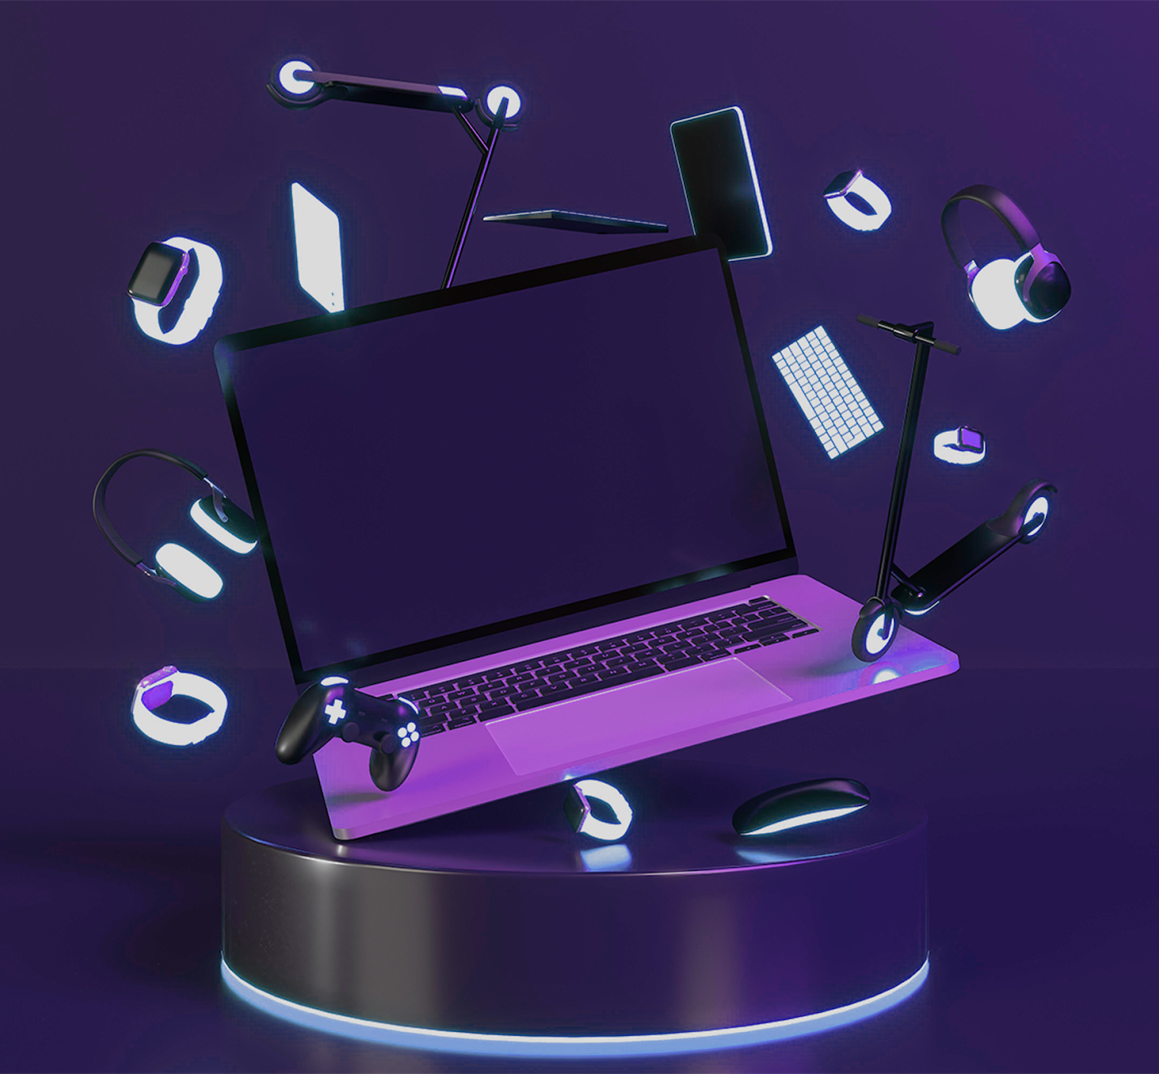

PROJECT OBJECTIVE
The objective of this project is to create a computer vision-based mouse controller using Python libraries like OpenCV and pynput. The system captures video input from a webcam, detects the user's hand gestures, and translates them into mouse actions such as left-clicking and cursor movement. By tracking the movement and positions of the user's hand in front of the camera, it enables intuitive interaction with the computer without the need for traditional input devices like a mouse or touchpad.

Slide 3
SCOPE OF PROJECT
The scope of this project includes implementing various computer vision techniques to achieve robust hand gesture detection and tracking. This involves:
Utilizing OpenCV for image processing tasks such as color segmentation, morphological operations, and contour detection to identify and track the user's hand gestures accurately.
Integrating pynput library to simulate mouse actions based on the detected hand gestures, including left-clicking and cursor movement.
Implementing a graphical user interface (GUI) using libraries like wxPython to provide a user-friendly interface for adjusting settings and displaying the camera feed.
Optimizing the performance of the system to ensure real-time responsiveness and smooth interaction between the user's hand movements and the computer's cursor actions.
Testing the system across different lighting conditions and hand gestures to validate its robustness and accuracy in various scenarios.
Providing documentation and instructions for users to set up and use the hand gesture-controlled mouse effectively.Overall, the project aims to create an intuitive and efficient hand gesture-based mouse control system that enhances user interaction with computers, particularly in scenarios where traditional input devices are not feasible or convenient to use.

Slide 4
PROPOSED METHODS
To enhance the hand-tracking application, several proposed methods can be implemented. Firstly, refine gesture recognition by defining specific conditions for each action, such as clicking or dragging, using precise hand landmark data. Incorporate a gesture history tracking system to detect patterns like double clicks or drags with more accuracy. Adjust gesture sensitivity and calibration based on user feedback for improved performance and adaptability. Provide users with visual or auditory feedback to confirm recognized gestures, improving their experience. Implement robust error handling for hand tracking failures and introduce fallback methods for when gestures are not detected. Optimize performance by downscaling video frames or using efficient algorithms to increase speed. Adapt contextual actions based on the user's activity and application state. Lastly, improve logging for tracking performance and debugging and consider expanding to multi-hand tracking for greater versatility. These methods aim to improve the accuracy, user experience, and functionality of the hand-tracking application.

Slide 5

ALGORITHM
1. Gesture Detection : Track hand landmarks to identify specific gestures like clicking, dragging, scrolling, and zooming based on finger positions.
2.Sensitivity Calibration : Allow users to adjust gesture sensitivity thresholds for more precise recognition and customization.
3.Feedback Mechanism :Provide visual or auditory feedback for recognized gestures to enhance the user experience.
4.Error Handling: Implement fallback methods for hand tracking failures and unrecognized gestures to maintain functionality.
5.Performance Optimization :Optimize frame processing using efficient algorithms and downscaling to improve speed and real-time performance.

Slide 6
TOOLS USED
PYTHON
OPENCV
01
02
PYNPUT
WXPYTHON
03
04
The primary programming language used for development.
A powerful open-source computer vision library
A Python library used for controlling input devices
A GUI toolkit for the Python programming language

Slide 7
SYSTEM DESIGN
The system architecture for the hand gesture-controlled mouse consists of:
Input Module: Captures video input from a webcam.
Image Processing Module: Processes video frames using OpenCV for hand gesture detection.
Gesture Recognition Module: Analyzes hand gestures to recognize specific actions.
Mouse Control Module: Maps recognized gestures to corresponding mouse actions using pynput.
User Interface Module: Provides a GUI for user interaction and settings adjustment.
Integration and Optimization: Integrates modules for seamless operation and optimizes performance . This modular design ensures efficient hand gesture detection and accurate mouse control, enhancing user interaction with the system.

Slide 8
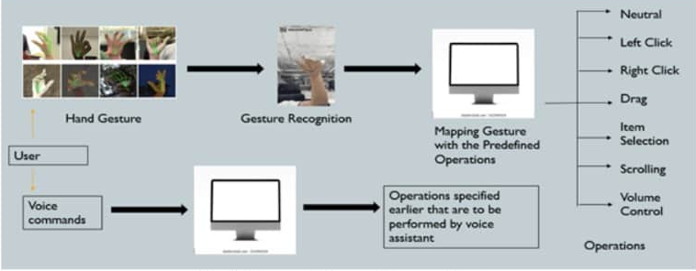
ARCHITECTURAL DIAGRAM

Slide 9
IMPLEMENTATION DETAILS
VIDEO INPUT
IMAGE PROCESSING
MOUSE CONTROL
OPTIMIZATION
Utilizes OpenCV to access the webcam
Applies color segmentation, morphological operations
Uses the pynput library to simulate mouse actions
Optimizes performance by parallelizing tasks

Slide 10
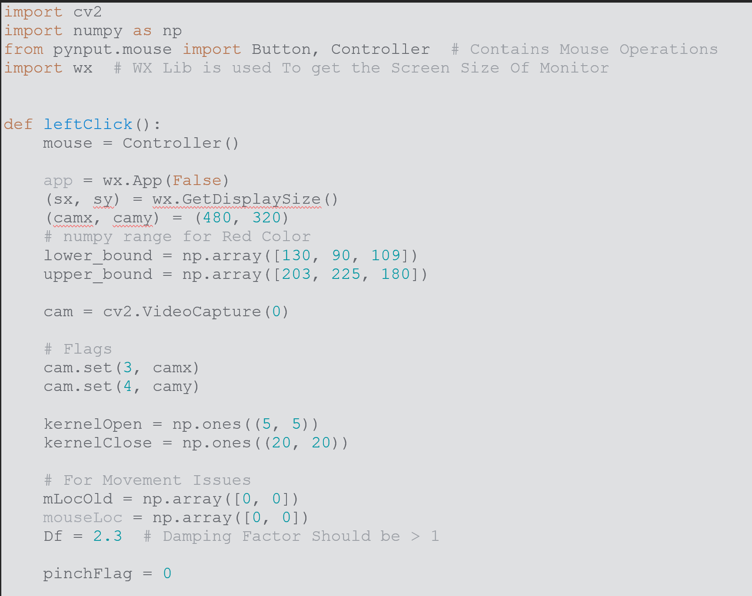
PREVIOUS INPUT

Slide 11
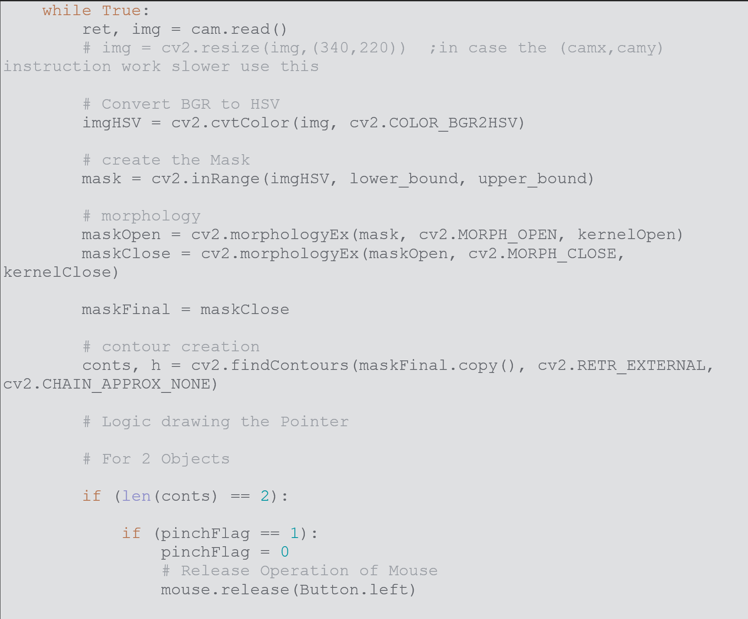
PREVIOUS INPUT

Slide 12
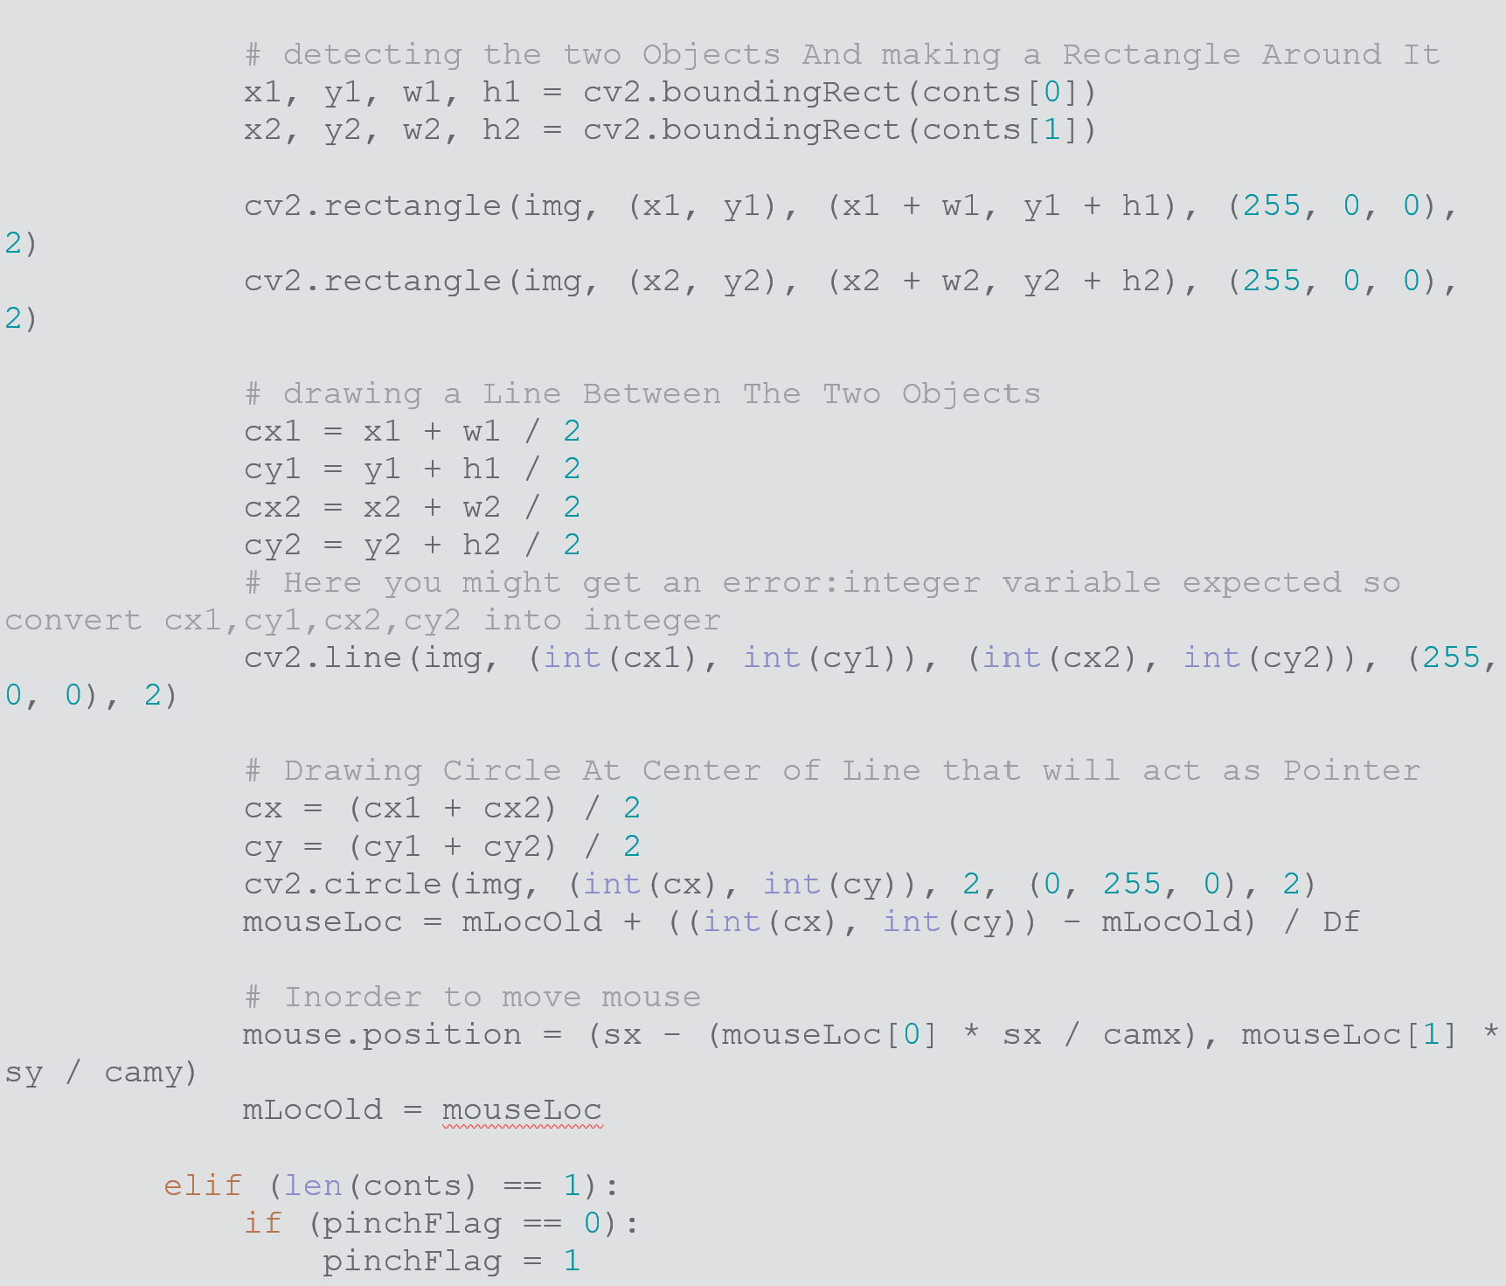
PREVIOUS INPUT

Slide 13
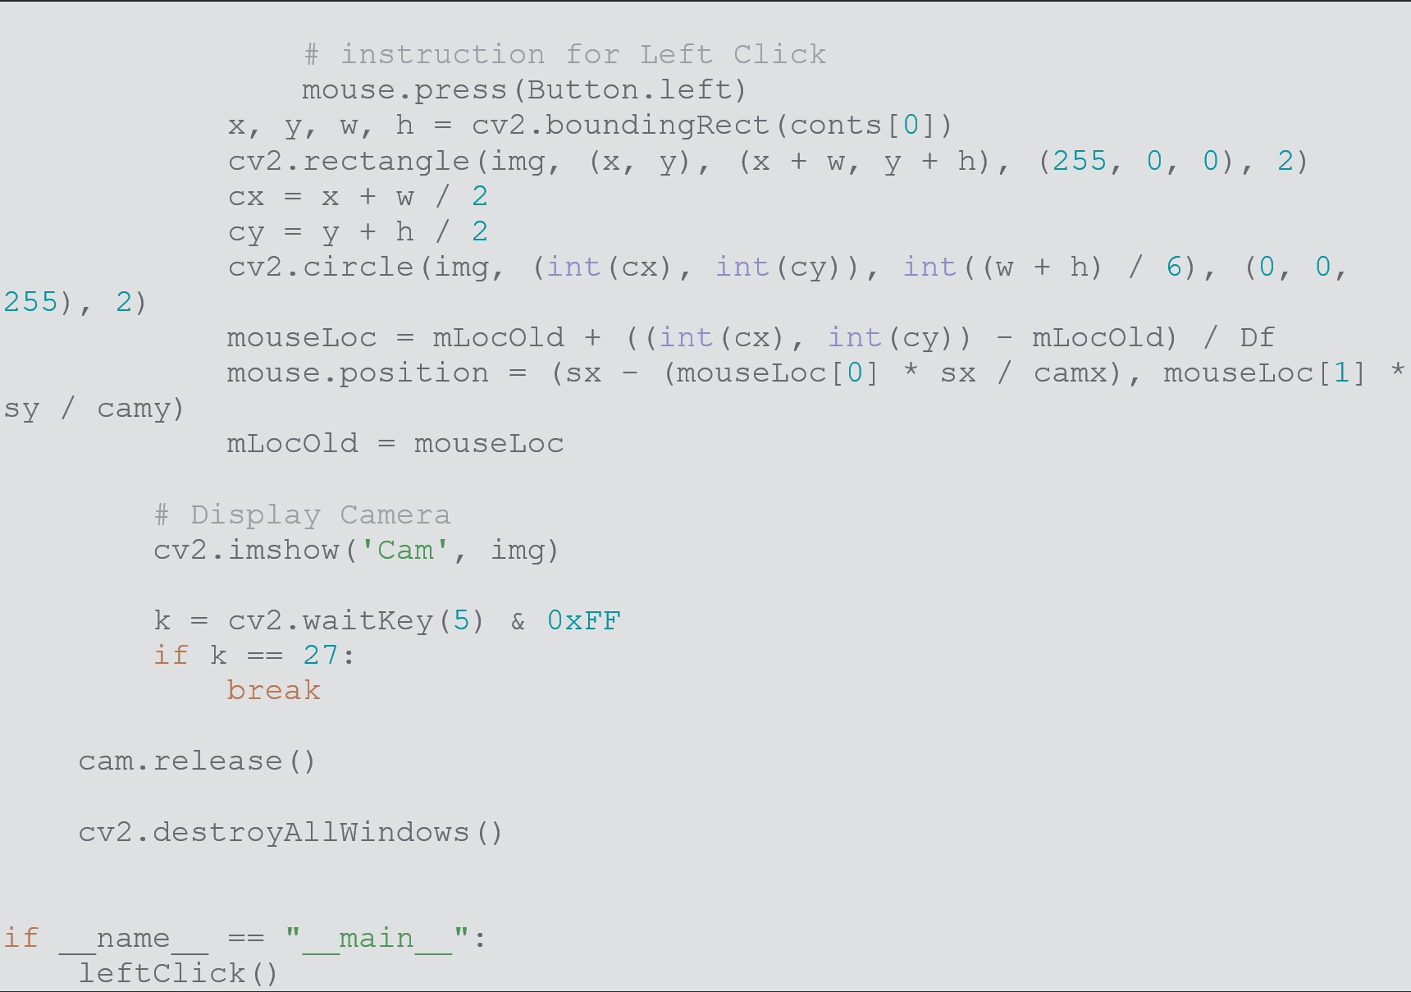
PREVIOUS INPUT

Slide 14
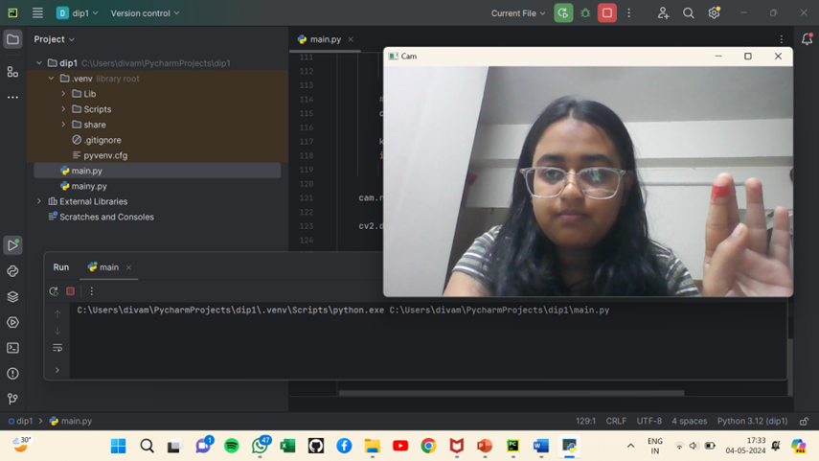
PREVIOUS OUTPUT

Slide 15
CODE IMPROVEMENTS
1. Gesture Recognition:
- Implemented `GestureManager` class to encapsulate gesture recognition logic.
- Used precise hand landmarks from MediaPipe's hand tracking for detailed gesture detection.
2. Cursor Movement:
- Used more nuanced logic to detect and control cursor movement, including cursor freezing for smoother transitions.
- Leveraged hand landmarks for precise positioning.
3. Clicking and Dragging:
- Defined clear conditions for different types of clicks (left, right, and double clicks) using finger positions.
- Implemented dragging detection using all finger positions.
4. Scrolling and Zooming:
- Added methods to detect scrolling gestures (up and down) based on specific finger positions.
- Included zooming detection using specific finger combinations and distance measurements.
making hand tracking more reliable, versatile, and responsive, enhancing the user's experience and interaction with the application.

Slide 16
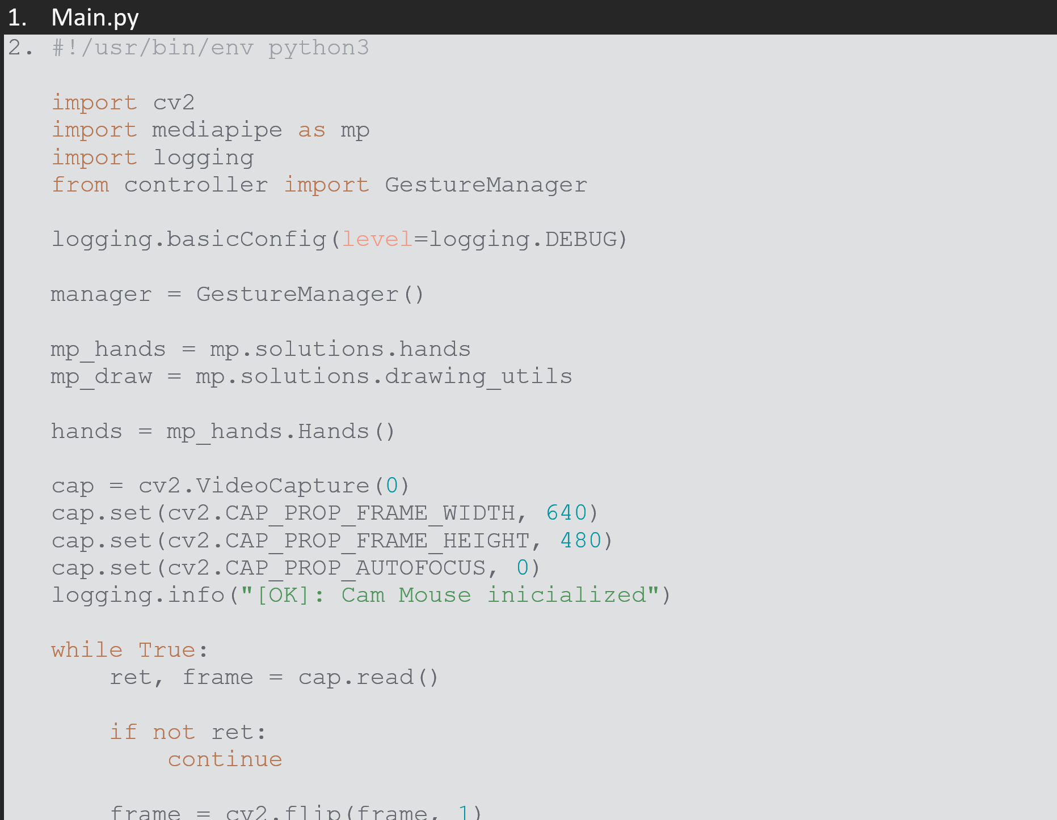
FINAL INPUT

Slide 17
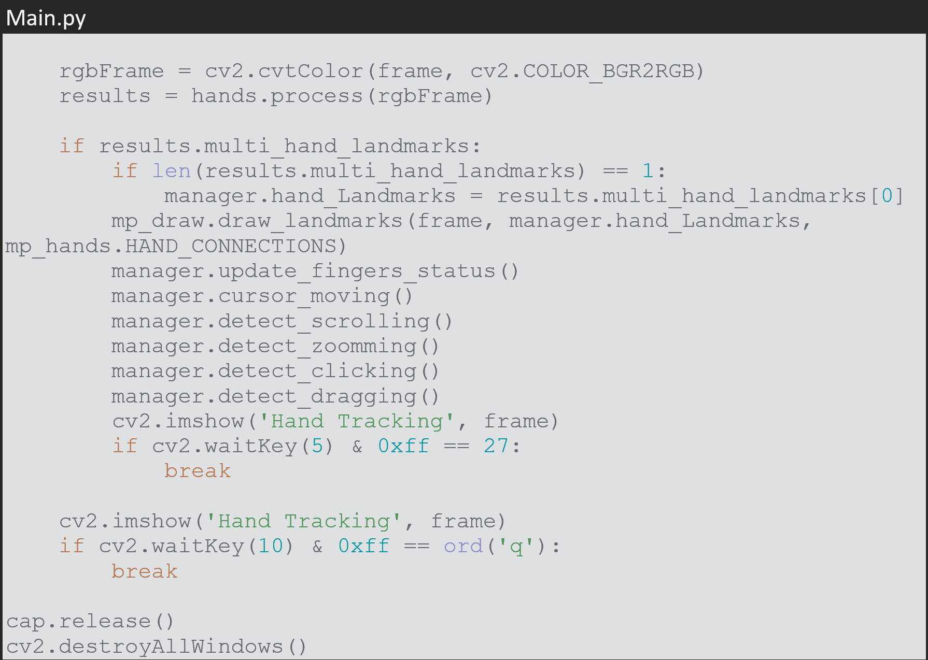
FINAL INPUT

Slide 18
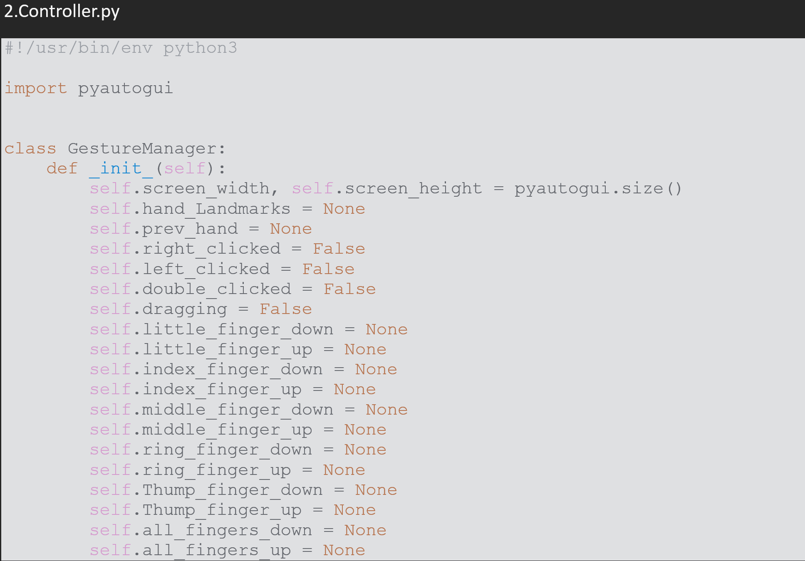
FINAL INPUT

Slide 19
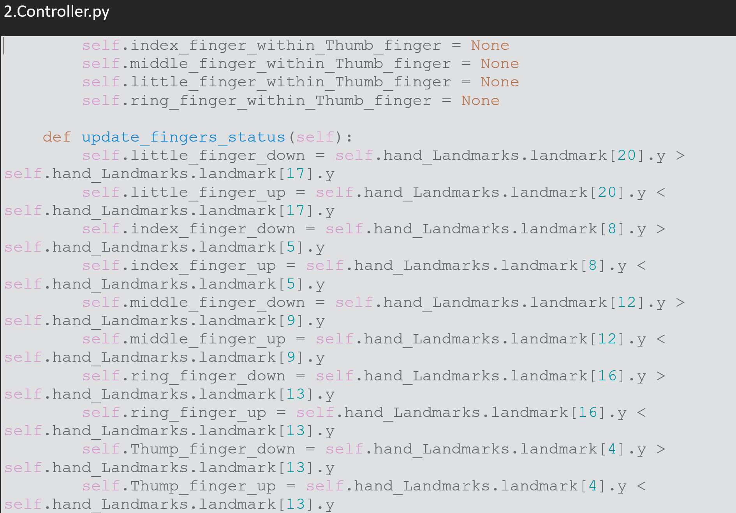
FINAL INPUT

Slide 20
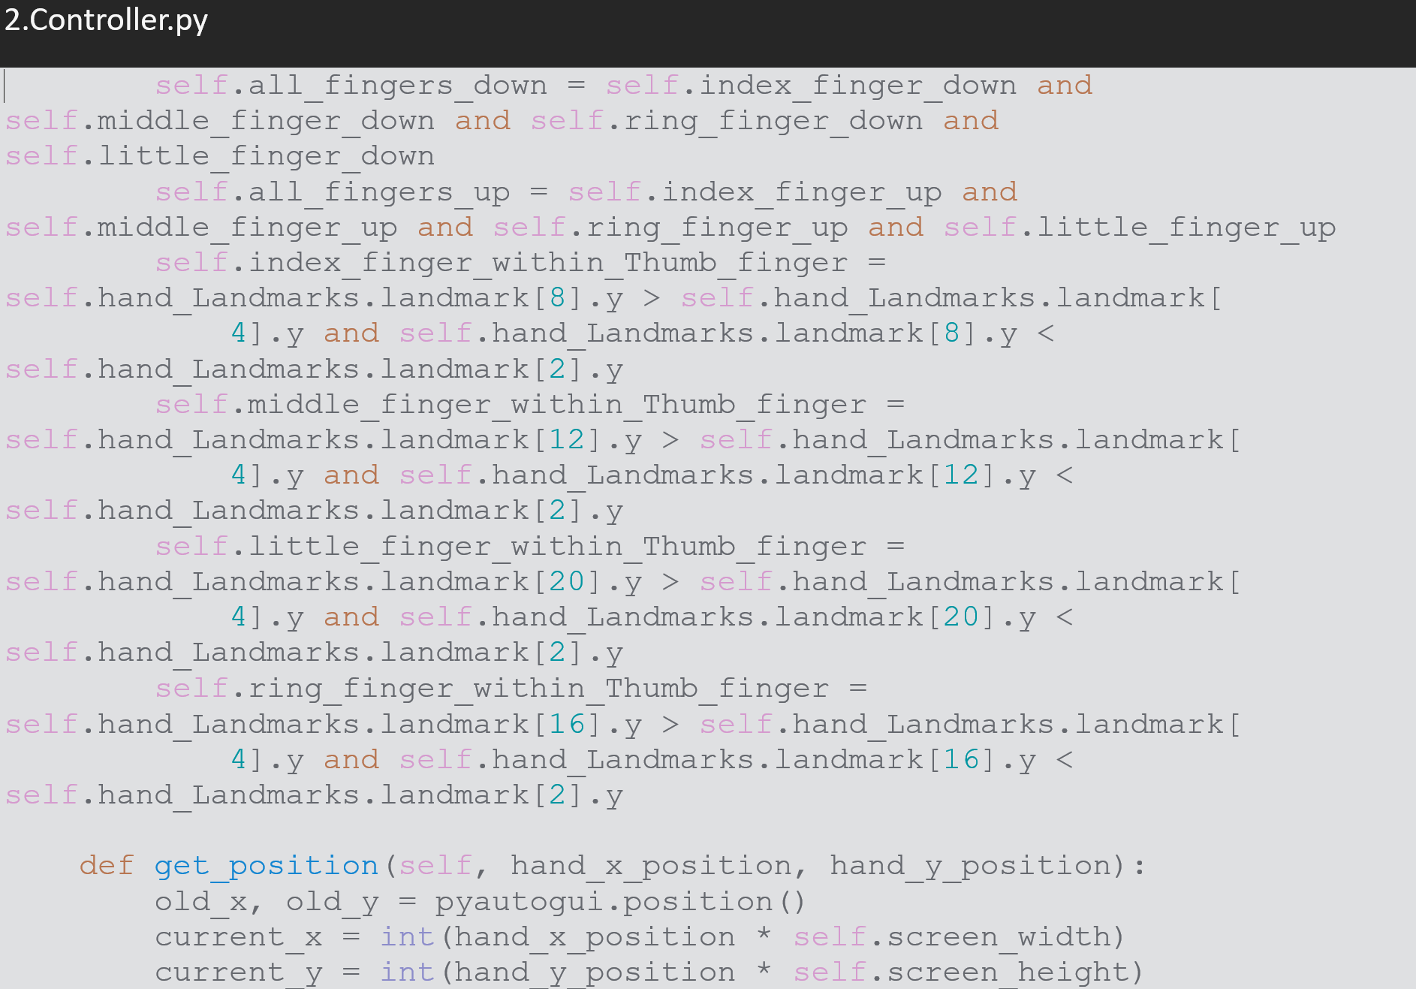
FINAL INPUT

Slide 21
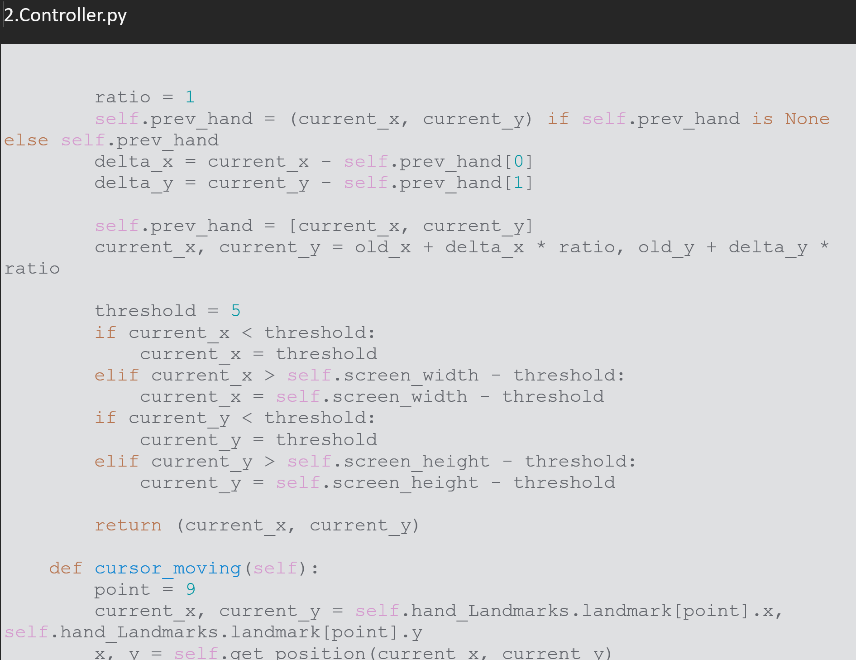
FINAL INPUT

Slide 22
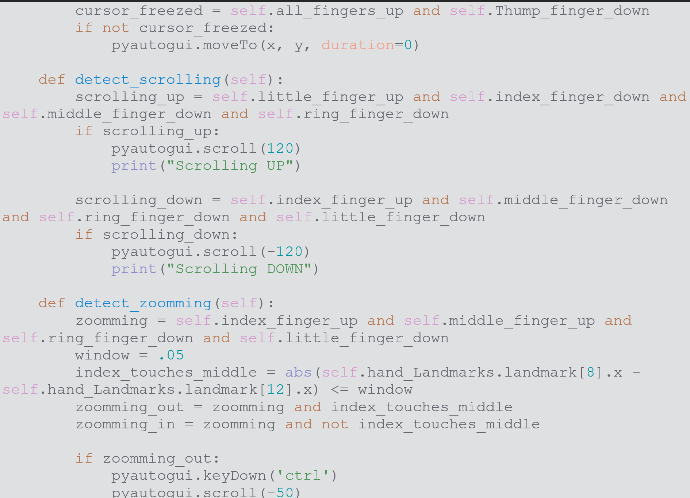
FINAL INPUT

Slide 23
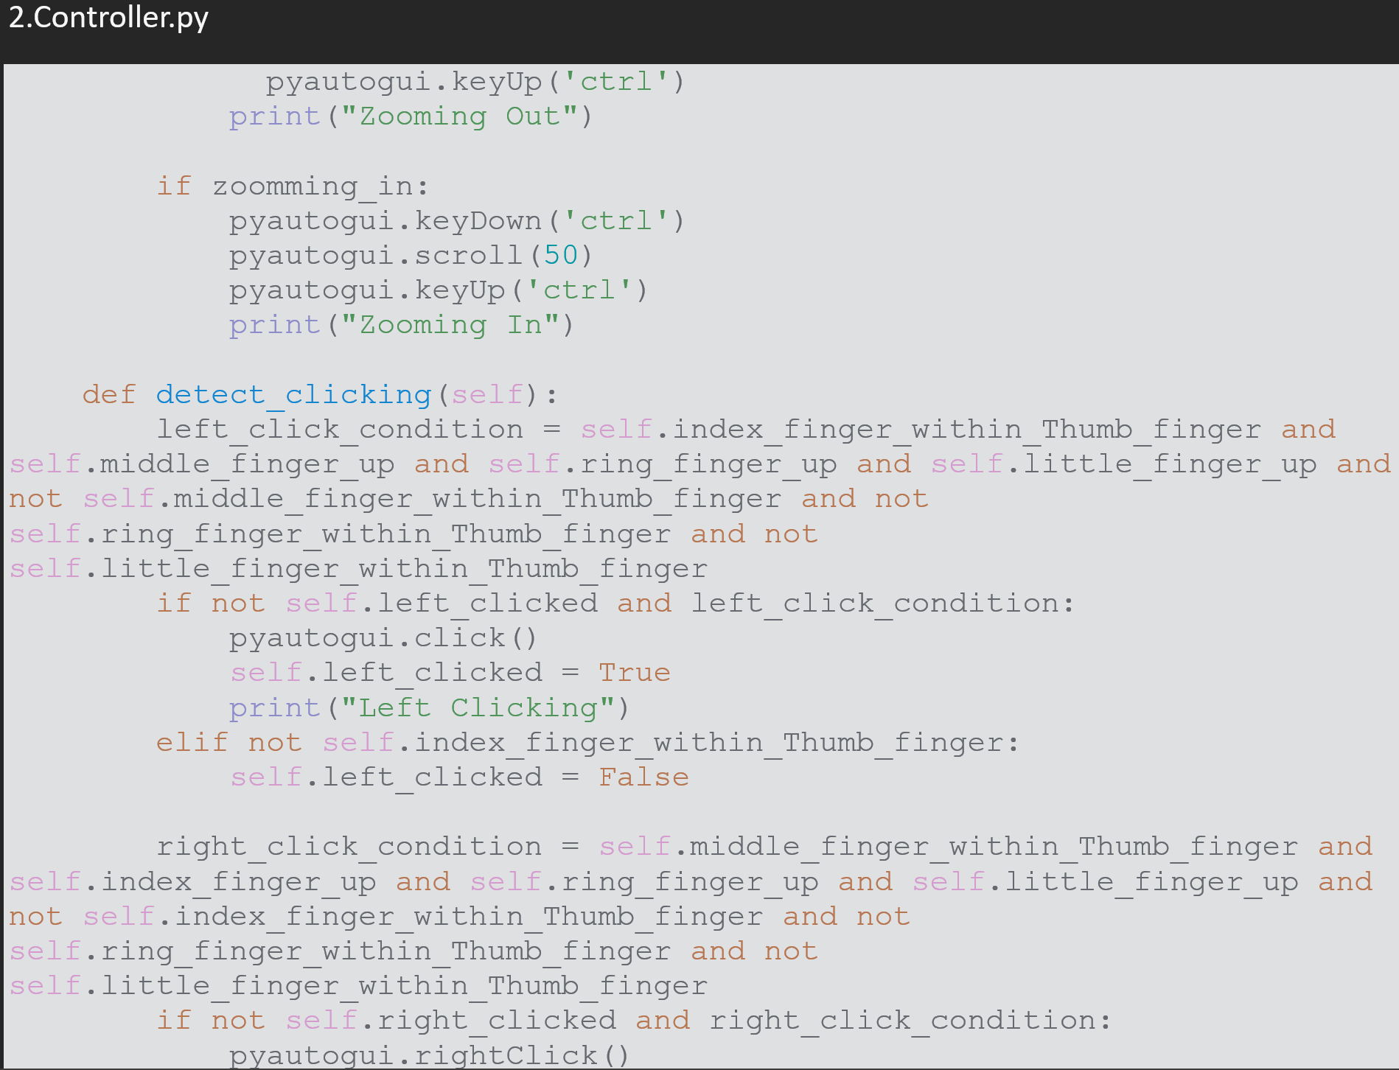
FINAL INPUT

Slide 24
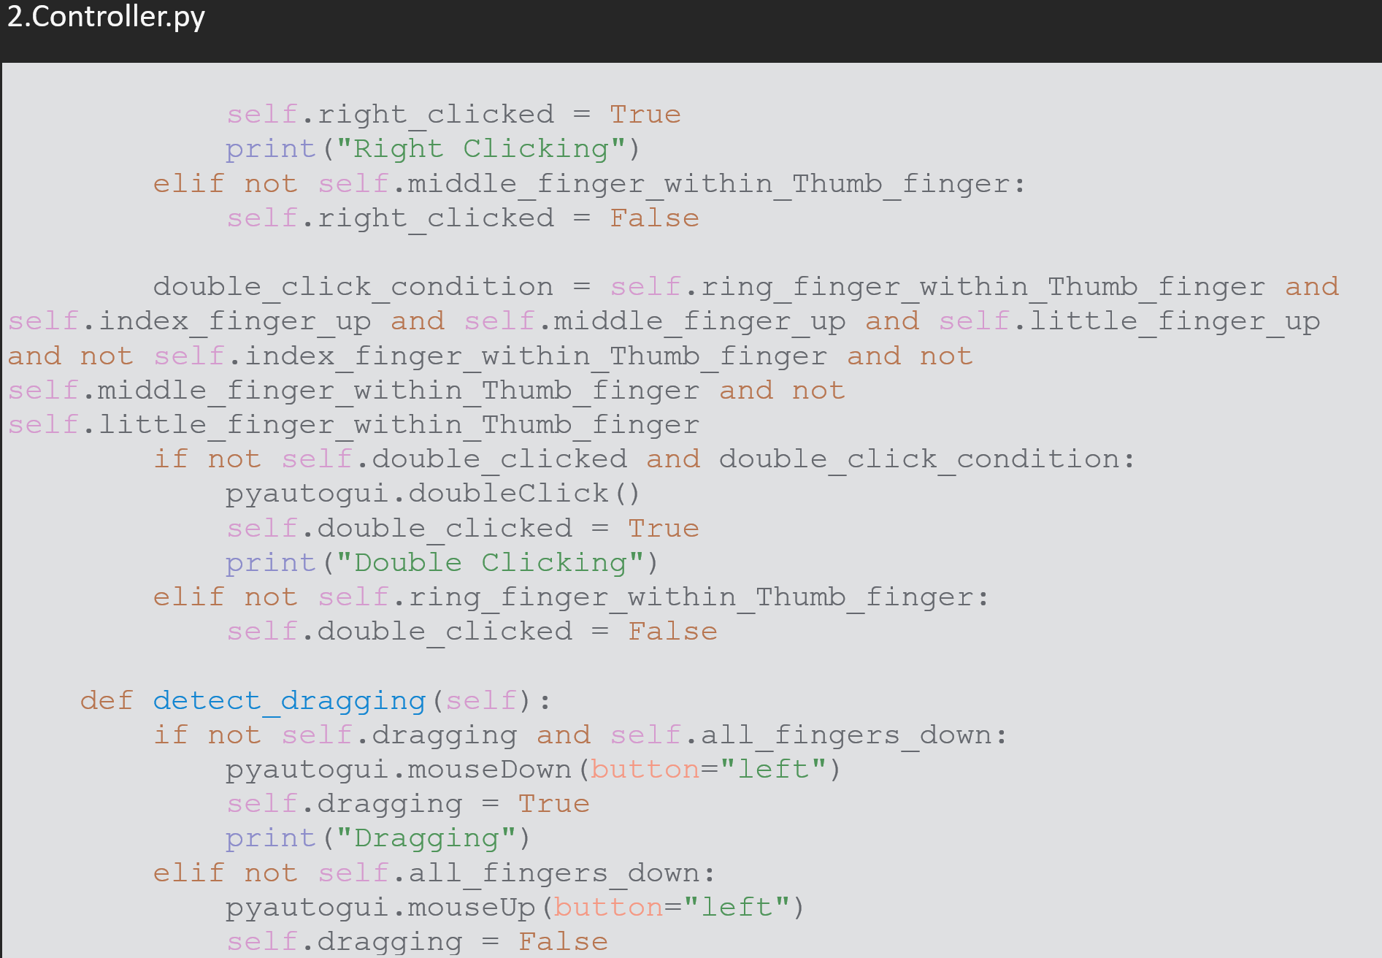
FINAL INPUT

Slide 25
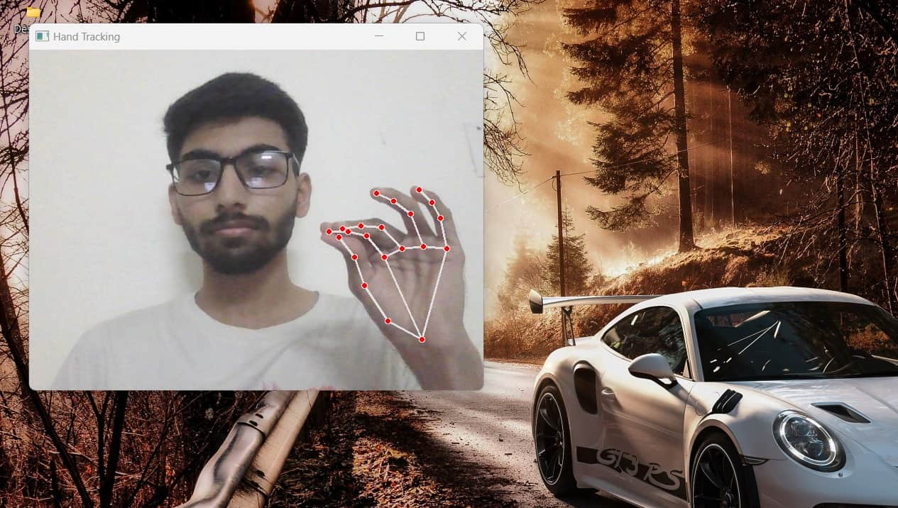
FINAL OUTPUT

Slide 26
RESULTS
The results of the hand gesture-controlled mouse system include:
Accurate Gesture Detection: The system effectively identifies and tracks hand gestures in real-time, allowing users to control the mouse cursor with precision.
Responsive Mouse Actions: Mouse actions, such as cursor movement and clicking, are executed promptly in response to recognized gestures, providing a seamless user experience.
Intuitive Interaction: Users can intuitively interact with the computer using hand gestures, eliminating the need for traditional input devices and enhancing accessibility.
Customizable Settings: The graphical user interface (GUI) allows users to adjust settings such as gesture sensitivity and color thresholds to tailor the system to their preferences and environment.
Robust Performance: Extensive testing ensures the system's robustness across various lighting conditions, hand gestures, and user interactions, maintaining reliable performance.
Overall, the hand gesture-controlled mouse system delivers accurate, responsive, and intuitive interaction with the computer, empowering users with an alternative input method that enhances productivity and accessibility.

Slide 27
CONCLUSION
In conclusion, the hand gesture-controlled mouse system presents an innovative approach to human-computer interaction, leveraging computer vision techniques and gesture recognition algorithms to enable intuitive control of the mouse cursor through hand gestures. By harnessing the power of OpenCV for image processing and pynput for mouse control, the system delivers accurate and responsive performance, allowing users to navigate the computer interface seamlessly.The implementation of a graphical user interface (GUI) further enhances the user experience by providing customization options and visual feedback on detected gestures and cursor movement. Extensive testing ensures the system's robustness and reliability across various scenarios, making it suitable for practical use in real-world environments.Overall, the hand gesture-controlled mouse system offers an accessible and efficient alternative to traditional input devices, opening up new possibilities for interaction with computers and enhancing accessibility for users with diverse needs. With further refinement and optimization, this technology has the potential to revolutionize human-computer interaction and improve user productivity and satisfaction.

Slide 28
TEAM DETAILS
RA2211003011034 DIVA MERJA
RA2211003011035 MAKADIA YAKSHKUMAR VIJAYKUMAR
RA2211003011045 KRISHNA WADHWANI
THANK YOU

